Slide 1
OVERVIEW OF
MICROSOFT EXCEL &
PROGRAMMING LANGUAGES

Slide 2
CONTENTS :
  Fundamentals of Excel
  Fundamentals of R Programming
  Fundamentals of Python
  Brief about Nielsen

Slide 3
Introduction to Excel
  Microsoft Excel is a spreadsheet program used to record and analyse numerical and statistical data.
  Microsoft Excel provides multiple features to perform various operations like calculations, pivot tables, graph tools, macro programming, etc.
  A Excel spreadsheet can be understood as a collection of columns and rows that form a table.

Slide 4
Basic Tools of Excel
V-lookup (Vertical lookup)
H-lookup (Horizontal lookup)
Pivots
Graphical Representation
Text to columns
Concatenate
Filter
Remove Duplicates
Conditional Formatting
Data Analysis tool pack and many more…

Slide 5
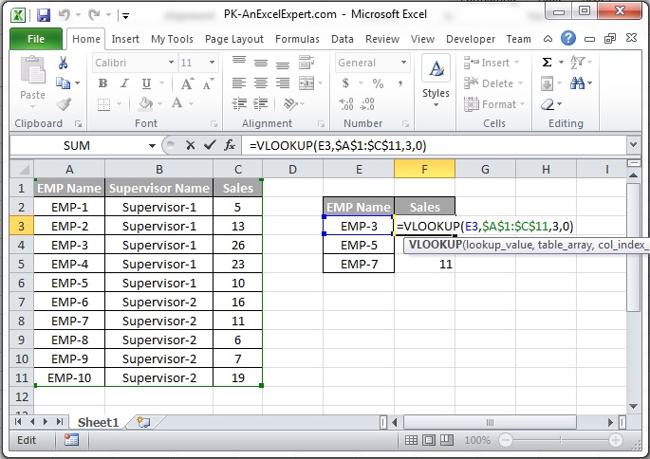
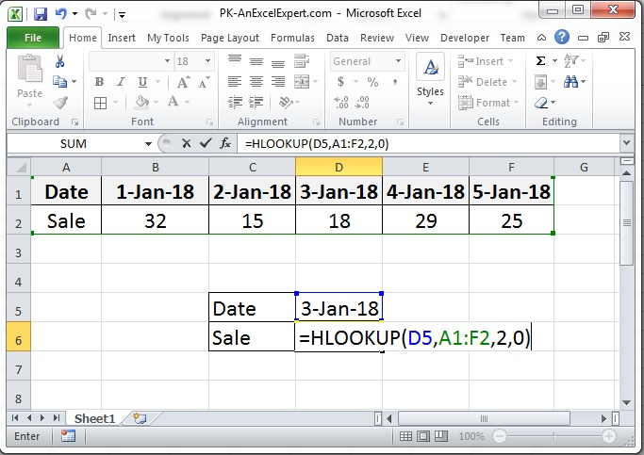
VLOOKUP
HLOOKUP
VLOOKUP formula performs a vertical lookup by searching for a value in the first column of a table and returning the value in the same row in the index number position.
HLOOKUP formula performs a horizontal lookup by searching for a value in the top row of the table and returning the value in the same column based on the index number.

Slide 6
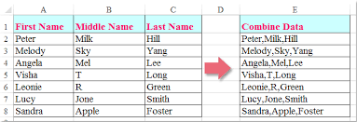
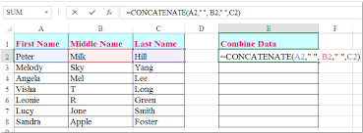
Pivots :
PivotTable to summarize, analyze, explore, and present summary data.
PivotCharts complement PivotTables by adding visualizations to the summary data in a PivotTable, and allow you to easily see comparisons, patterns, and trends.
Both PivotTables and PivotCharts enable you to make informed decisions about critical data in your enterprise.
Graphical Representation :
In Microsoft Excel, charts are used to make a graphical representation of any set of data.
A chart is a visual representation of data, in which the data is represented by symbols such as bars in a bar chart or lines in a line chart.
Concatenate :

Slide 7
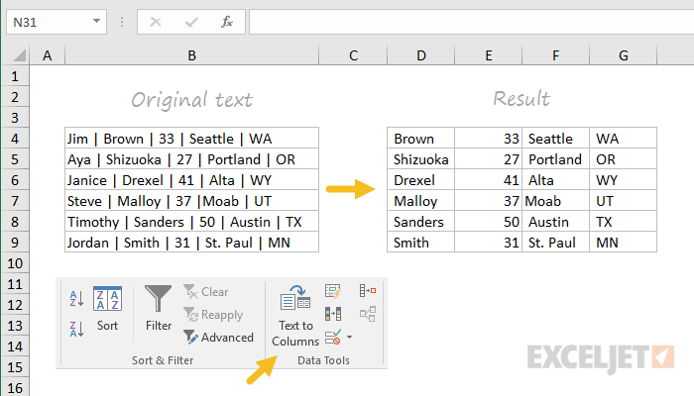
Text To Column :

Slide 8
Condition Formatting :
Conditional formatting is a feature in many spreadsheet applications that allows you to apply specific formatting to cells that meet certain criteria.
It is most often used as color-based formatting to highlight, emphasize, or differentiate among data and information stored in a spreadsheet
Remove Duplicate :
Select the range of cells that has duplicate values you want to remove. Tip: Remove any outlines or subtotals from your data before trying to remove duplicates.
Click Data > Remove Duplicates, and then Under Columns, check or uncheck the columns where you want to remove the duplicates. ...
Click OK.
Data Analysis Tool Pack :
It is used to obtain regression model, correlation, covariance and many more…..

Slide 9
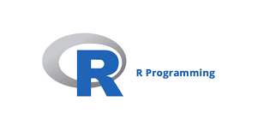
What is R Programming language
  R is a software environment and statistical programming language built for statistical computing and data visualization.
  Developed by Ross Ihaka and Robert Gentleman.
  Used in Data Analytics and Business Analytics.
  R’s numerous abilities to tend to fall into three broad categories
  Manipulating data
  Statistical analysis
  Visualizing data

Slide 10
Key Difference between R and Python
R | Python
R is mainly used for statistical analysis and graphical representation. | Python is used as a general purpose language for development .
R has visualization library like ggplot2,plotly etc. | Python has visualization libraries like matplotlib , seaborn and bokeh etc.
Lower speed than Python | It is faster than R
It is less popular . | It has more popularity
R is better used for data visualization . | Python is better for deep learning.
RStudio is IDE for R | Jupyter notebook , Spyder ,Pycharm etc. are IDE for python
Code is not easily Readable | Code is more readable

Slide 11



DATA TYPES
Vector
Matrix
Data Frame
>x =data.frame(g=c('m','f'),age=c(22,23),job=c(F,T))
> x
g age job
1 m 22 FALSE
2 f 23 TRUE
> x = c(2,"hi",2.3,T)
> x
[1] "2" "hi" "2.3" "TRUE"
> x = matrix(c(1,2,3,4),nrow = 2)
> x
[,1] [,2]
[1,] 1 3
[2,] 2 4

Slide 12
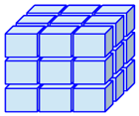

List
  > x = list(name = 'xyz',roll_no = '01')
  > x
  $name
  [1] "xyz"
  $roll_no
  [1] "01"
Array
> x = array(c(1:8),dim=c(2,2,2))
> x
, , 1
[,1] [,2]
[1,] 1 3
[2,] 2 4
, , 2
[,1] [,2]
[1,] 5 7
[2,] 6 8

Slide 13
DATA VISUALIZATION
  boxplot(…) : Box and whisker plot
  plot(…) : Scatter plot
  barplot(…) : Bar chart
  pie(…) : Pie chart
  hist(…) : Histogram
  stem(…) : Stem and leaf plot

Slide 14
PROBABILITY DISTRIBUTION
r… : Generate random deviates
p… : Distribution function P(X<=a)
d… : Calculate density P(X = a)
q… : Quantile function
  Example
pbinom(5, size=10, prob=0.4) = P(X<=5)
TESTING OF HYPOTHESIS
t.test(…)
var.test(…)
prop.test(…)
binom.test(…)
chisq.test(…)
ks.test(…)
wilcox.test(…)

Slide 15
Introduction to Python Programming
Python is a high-level object-oriented programming language that was created by Guido -van Rossum. It is also called general-purpose programming language as it is used in almost every domain we can think of as mentioned below :
    Web Development
    Software Development
    Game Development
    AI & ML
    Data Analytics

Slide 16
Why Python Programming?
Python has simpler syntax similar to the English language and also the syntax allows developers to write programs with fewer lines of code.
Since it is open-source there are many libraries available that make users jobs easy ultimately results in high productivity.
They can easily focus on business logic and Its demanding skills in the digital era where information is available in large data sets.

Slide 17
Datatypes:-
  Datatypes are the classification or categorization of data items.
  There are various datatypes in python.
  List
      It is an ordered sequence of items.
      Lists are mutable.
      Ex: [1,2,’python’]
  String
      A string is sequence of characters.
      Strings are immutable.
      Ex: my_string=“hello”
  Tuple
      A tuple is a sequence of values. The values can be of any type.
      Tuples are immutable.

Slide 18
    4. Dictionary
      Dictionary is an unordered collection of key-value pairs.
      Values in a dictionary can be of any data type can be duplicated, whereas key can’t be must repeated and must be immutable.
NumPy Array :
NumPy is a python library used for working with arrays.
      Creating NumPy arrays
Using other python structures
Using in built-in NumPy functions
      Indexing NumPy array
Two kinds are indexing are available:
          1. Basic indexing
            Field access
            Slicing
2. Advanced indexing
            Using bool array as index
            Fancy indexing

Slide 19
Random Number Generator
The purpose of using this function is to generates random number which can used in sampling.
The random submodule provides a built in function “default_rng()” for creating generator object.
Built in function for random number generator :
- randint(x, y)
- random()
- choice(seq)
- randrange(start, stop, step)
- normal

Slide 20
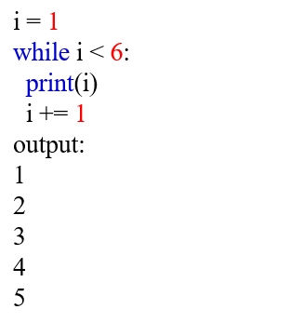
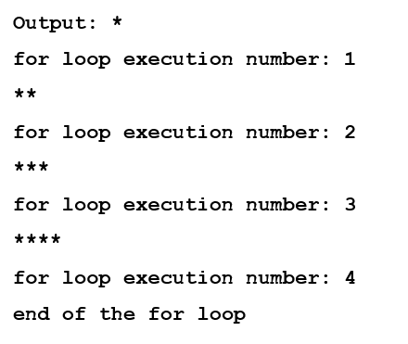
Python Loops:
The while Loop
With the while loop, we can execute a set of statements as long as a condition is true.
Print i as long as i is less than 6:
Python For Loops
A for loop is used for iterating over a sequence (that is either a list, a tuple, a dictionary, a set, or a string).
for i in range(4):
print('*'*(i+1))
print("for loop execution number:",i+1)
print("end of the for loop")
The while loop requires relevant variables to be ready, in this example we need to define an indexing variable, i, which we set to 1.

Slide 21
Pandas:
  Pandas is a Python Package that provides a powerful Data analysis and manipulation library for Python.
  Pandas is built on top of NumPy.
Importing data from text files:-
  pandas provide several functions for reading tabular data into a Data Frame object.
  read_csv function
Series:
      Pandas series is a one-dimensional labelled array capable of holding data of any type (integer, string, float, etc).
      The axis label's are collectively called index
Data Frame:
      A Data Frame is a two-dimensional data structure, which can be visualized in a tabular form. The two axes, called rows and columns.
      A Data Frame is most suitable for storing multivariate statistical data.
      Rows are labelled by ‘Index’ and columns are labelled by 'columns’.

Slide 22
Groupby Function :
    Split the data in to multiple groups > Perform some operation on each group >Combine the results.
    This workflow can be implemented in python using a groupby facility provided by pandas.
The SciPy library :
    SciPy in Python is an open-source library used for solving mathematical, scientific, engineering, and technical problems.
    It allows users to manipulate the data and visualize the data using a wide range of high-level commands.
Object Oriented Programming :
    Object-oriented programming is a programming paradigm that provides a means of structuring programs so that properties and behaviors are bundled into individual objects.
StatsModels :
    Statsmodels is a Python package that provides classes and functions for fitting many different statistical models, for performing statistical tests, and carrying out data exploration.
Model fitting using formula API :
    statsmodels supports specification of models using R-style formula and pandas Data Frames.
    Internally, statsmodels uses the patsy package to convert formulas and data to the design matrices that are used in model fitting.

Slide 23
About Nielsen:-
NIELSEN is a market research organization.
    Founder: Arthur C. Nielsen.
    Revenue: 6.290 billion USD (2020)
    Headquarters: New York, United states
    CEO: David Kenny (Since 2018)
    The company is listed on the New York Stock Exchange (NYSE) and is currently a component of the S&P500.
Purpose :
      Provide its clients with valuable insights into consumer behaviour and marketing information
      Measure the audiences for television, radio, and newspapers in media markets.
      To predict consumer trends.
      Measures the shopping and media behaviour of millions of consumers around the world.

Slide 24
What is FMCG?
  Fast-moving consumer’s good are products that sell quickly at relatively low cost.
  Fast-moving consumer goods are nondurable products that sell quickly at relatively low cost.
  FMCGs have low profit margins and high-volume sales.

Slide 25


